Slide 1



Sales Analysis
View in Power BI
Last data refresh:
3/19/2022 5:06:57 AM UTC
Downloaded at:
4/6/2022 4:31:26 PM UTC

Slide 2
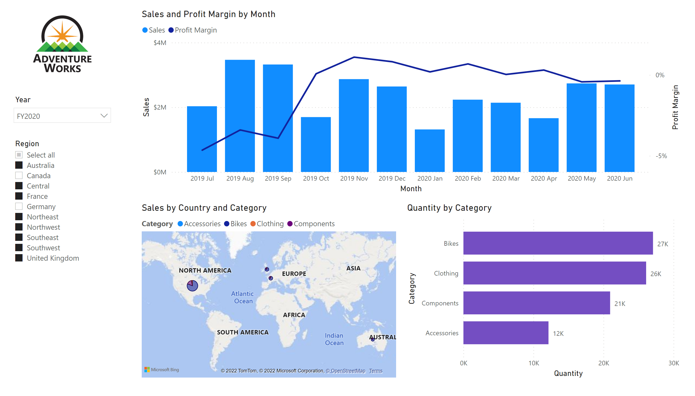
Overview
Notes:
image
No alt text provided
slicer
No alt text provided
slicer
No alt text provided
lineStackedColumnComboChart
No alt text provided
map
No alt text provided
barChart
No alt text provided

Slide 3
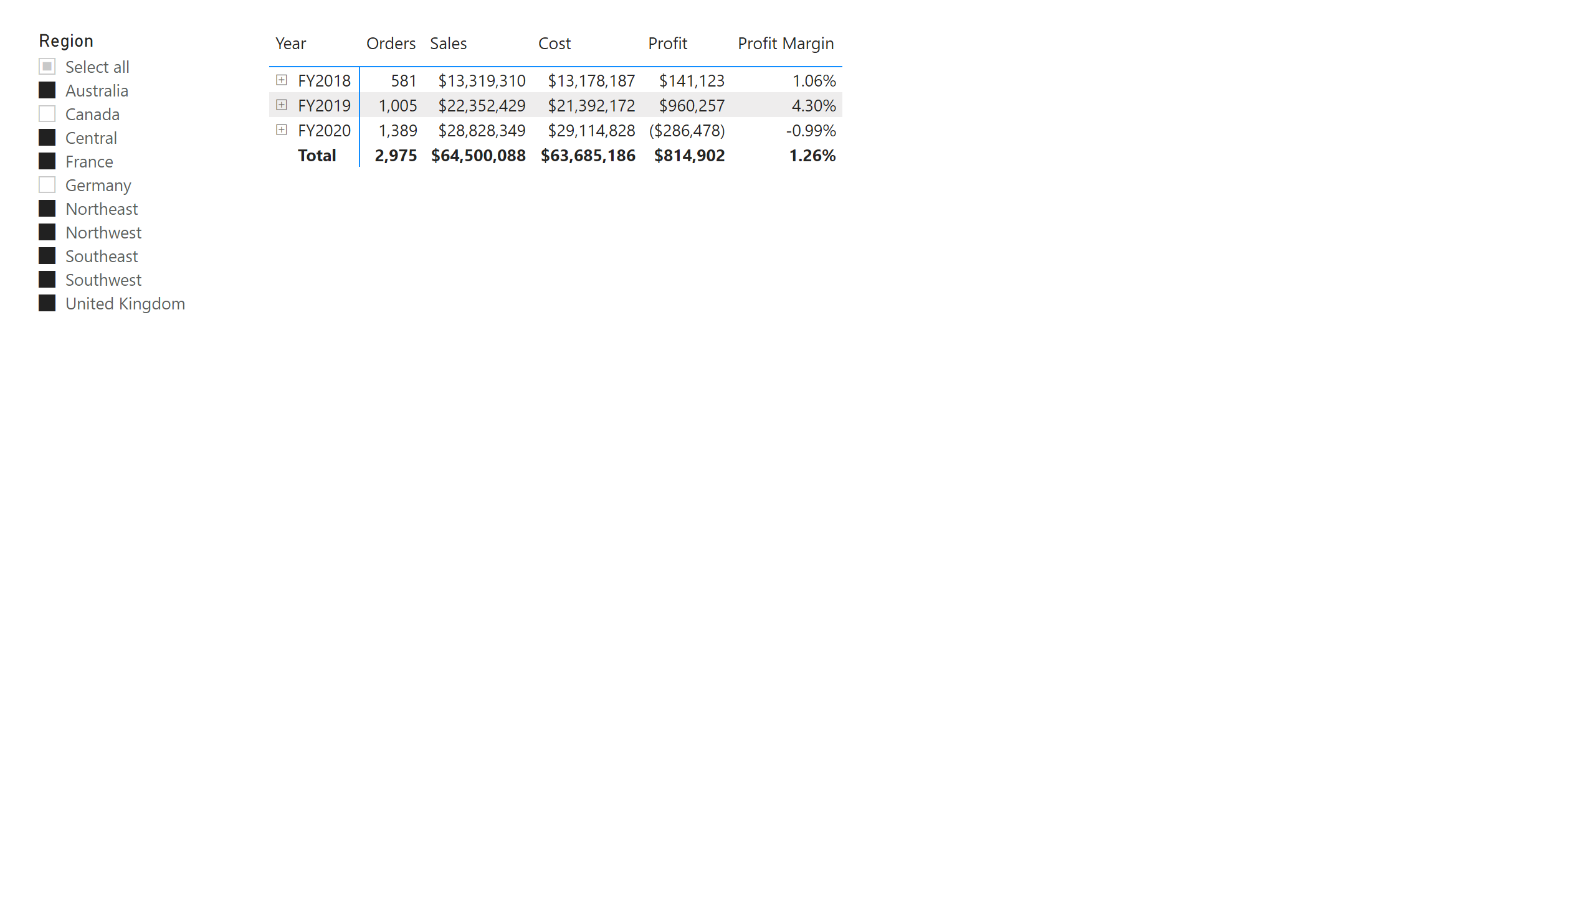
Profit
Notes:
slicer
No alt text provided
pivotTable
No alt text provided

Slide 4
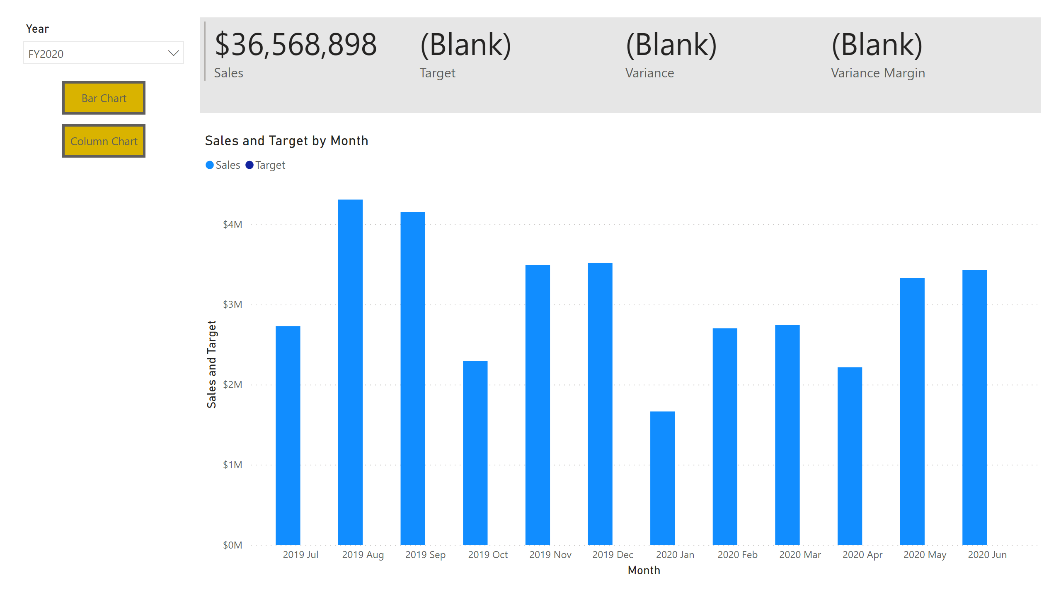
My Performance
Notes:
slicer
No alt text provided
multiRowCard
No alt text provided
clusteredBarChart
No alt text provided
clusteredColumnChart
No alt text provided
actionButton
No alt text provided
actionButton
No alt text provided

